Slide 1
Correlation
Prof. Andy Field

Slide 2
Aims
Measuring Relationships
Scatterplots
Covariance
Pearson’s Correlation Coefficient
Nonparametric measures
Spearman’s Rho
Kendall’s Tau
Interpreting Correlations
Causality
Partial Correlations

Slide 3
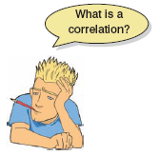
What is a Correlation?
It is a way of measuring the extent to which two variables are related.
It measures the pattern of responses across variables.

Slide 4
Very Small Relationship
Notes:
Appreciation of Norwegian Black metal Band Dimmu Borgin against age

Slide 5
Positive Relationship

Slide 6
Negative Relationship

Slide 7
Measuring Relationships
We need to see whether as one variable increases, the other increases, decreases or stays the same.
This can be done by calculating the Covariance.
We look at how much each score deviates from the mean.
If both variables deviate from the mean by the same amount, they are likely to be related.

Slide 8
Modeling Relationships
First, look at some scatterplots of the variables that have been measured.
Outcome_{i} = (model ) + error_{i}
Outcome_{i} = (bX_{i} ) + error_{i}

Slide 10
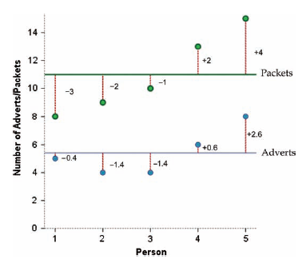

Slide 11
Revision of Variance
The variance tells us by how much scores deviate from the mean for a single variable.
It is closely linked to the sum of squares.
Covariance is similar – it tells is by how much scores on two variables differ from their respective means.

Slide 13
Covariance
Calculate the error between the mean and each subject’s score for the first variable (x).
Calculate the error between the mean and their score for the second variable (y).
Multiply these error values.
Add these values and you get the cross product deviations.
The covariance is the average cross-product deviations:

Slide 16
Problems with Covariance
It depends upon the units of measurement.
E.g. The Covariance of two variables measured in Miles might be 4.25, but if the same scores are converted to Km, the Covariance is 11.
One solution: standardise it!
Divide by the standard deviations of both variables.
The standardised version of Covariance is known as the Correlation coefficient.
It is relatively affected by units of measurement.

Slide 17
The Correlation Coefficient

Slide 18
The Correlation Coefficient

Slide 19
Correlation: Example
Anxiety and Exam Performance
Participants:
103 students
Measures
Time spent revising (hours)
Exam performance (%)
Exam Anxiety (the EAQ, score out of 100)
Gender

Slide 20
Conducting Correlation Analysis

Slide 21
Doing a Correlation

Slide 22
Correlation Output

Slide 23
Reporting the Results

Slide 24
Things to know about the Correlation
It varies between -1 and +1
0 = no relationship
It is an effect size
±.1 = small effect
±.3 = medium effect
±.5 = large effect
Coefficient of determination, r²
By squaring the value of r you get the proportion of variance in one variable shared by the other.

Slide 25
Correlation and Causality
The third-variable problem:
in any correlation, causality between two variables cannot be assumed because there may be other measured or unmeasured variables affecting the results.
Direction of causality:
Correlation coefficients say nothing about which variable causes the other to change

Slide 26
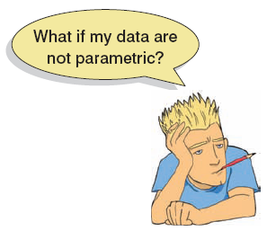
Nonparametric Correlation
Spearman’s Rho
Pearson’s correlation on the ranked data
Kendall’s Tau
Better than Spearman’s for small samples
World’s best Liar Competition
68 contestants
Measures
Where they were placed in the competition (first, second, third, etc.)
Creativity questionnaire (maximum score 60)

Slide 27
Correlation Output Spearman’s rho

Slide 28
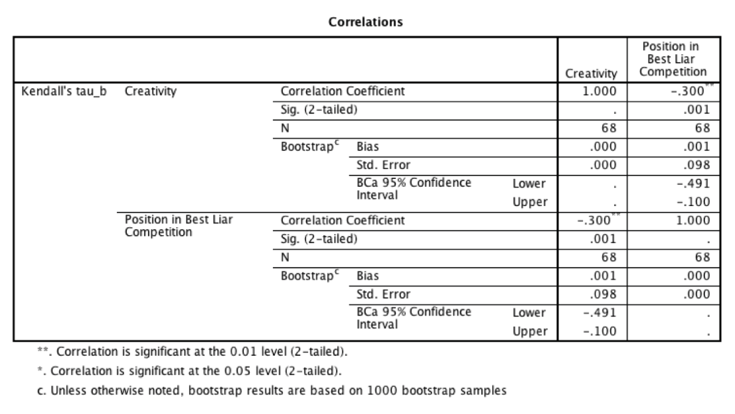
Correlation Output Kendall’s tau

Slide 29
Partial and Semi-Partial Correlations
Partial correlation:
Measures the relationship between two variables, controlling for the effect that a third variable has on them both.
Semi-partial correlation:
Measures the relationship between two variables controlling for the effect that a third variable has on only one of the others.

Slide 32
Doing Partial Correlation

Slide 33
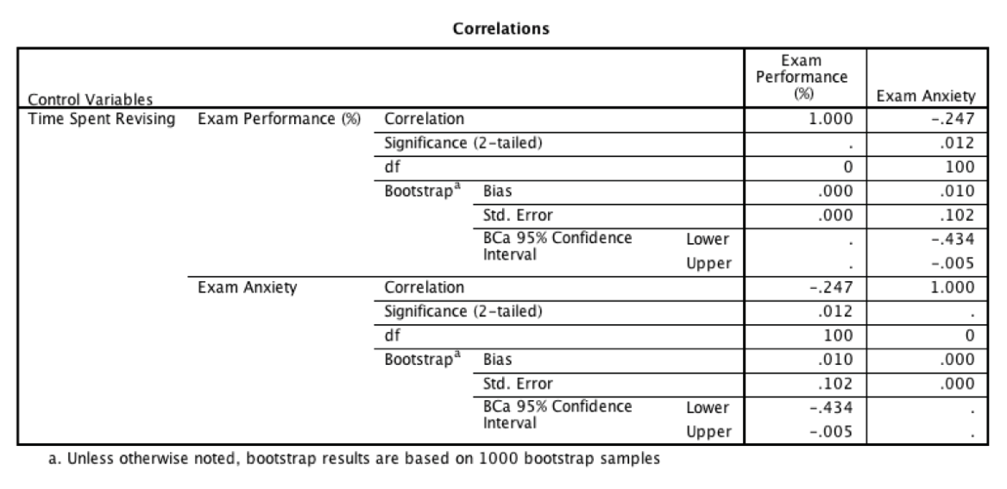
Partial Correlation Output

